Slide 1
United Health Services
Logistic Regression Analysis
Zachary Baker, Katrina Knickerbocker, Jonathan Lin, Debadutta Mishra, Michael Simmons

Slide 2
Agenda
01
02
03
04
05
06
Introduction
Data Preparation
Demographic Information
Analysis Results
Implications
Descriptive Statistics

Slide 3
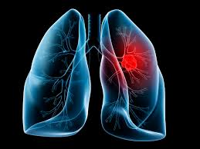
Introduction
Background Statistics:
In the US, than 130,000 deaths per year are attributed to lung cancer
16% of lung cancer cases are diagnosed at an early stage
More than half of people who receive a diagnosis die within a year
Research Questions: What are significant factors contributing to lung cancer history, and how can lung cancer screening be improved in Broome County?

Slide 4
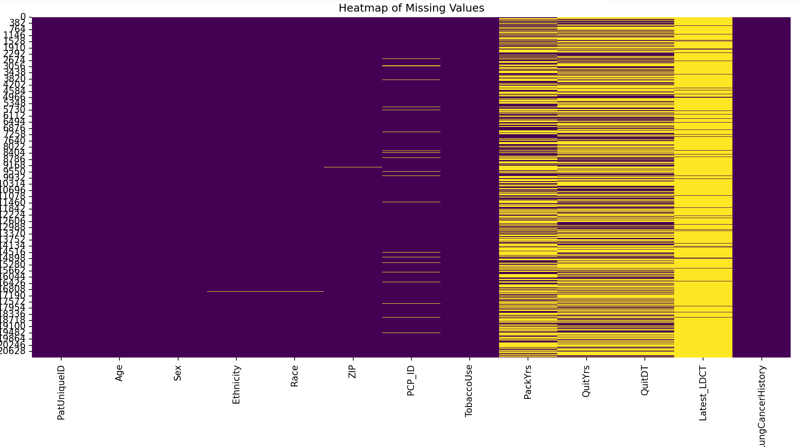

Data Preparation
Visualization of missing data to help determine course of action.

Slide 5
Data Preparation
PatUniqueID and PCP_ID: dropped, irrelevant to regression analysis
QuitDT dropped after computing QuitYrs based on QuitDT
2-3 records missing ZIP, Ethnicity, or Race. Those records were dropped as none of them had a positive Lung Cancer History
TobaccoUse, Ethnicity, and Race: converted into binary variables (ie TobaccoUse_Current Smoker/TobaccoUse_Former) and then one-hot encoded to create dummy variables
Latest_LDCT_Exists converted to binary flag
QuitYrs and PackYrs: addressed using regression, KNN, and MICE imputation methods for depending on model

Slide 6
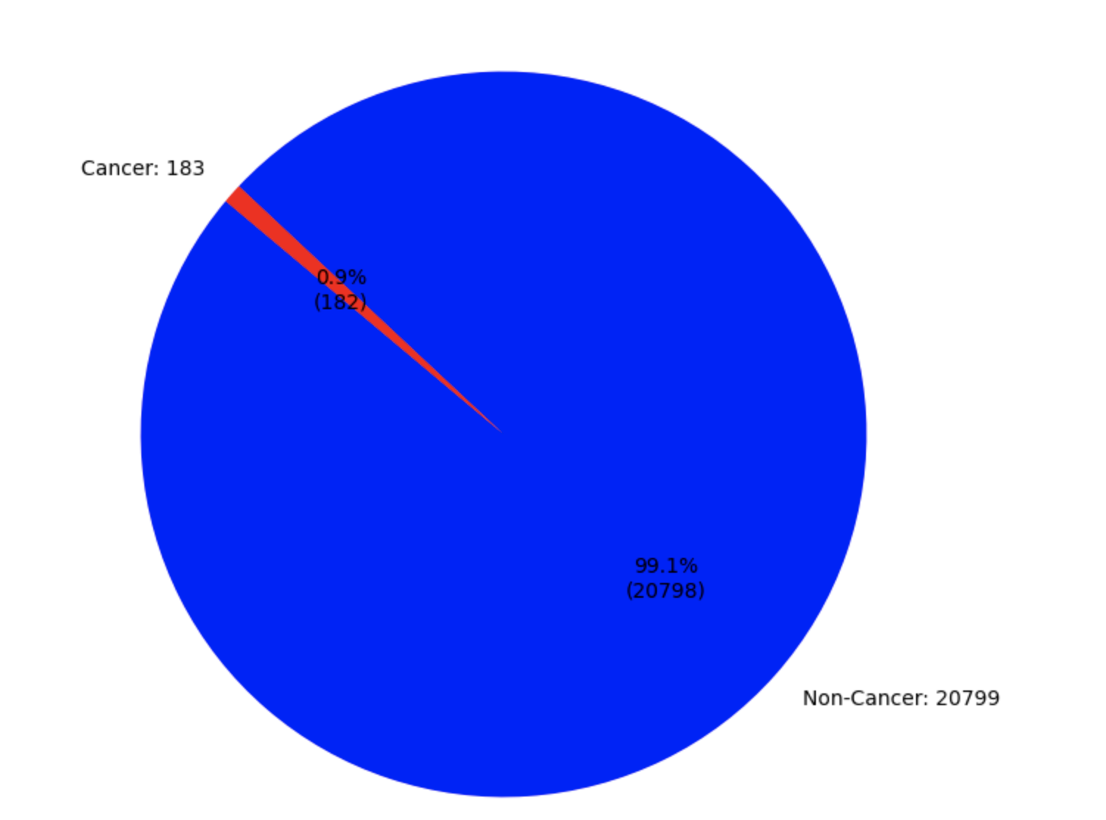
Demographic Information
Lung Cancer History:
Age: Avg = 58.65 Range = (45.03, 72.03)
Sex: Male = 49.13%, Female = 50.87%
Race: White = 91.42%, NonWhite = 8.58%
Ethnicity: Hispanic = 1.96%, Non Hispanic = 98.04%
Current Smoker: No = 62.3%, Yes = 37.70%

Slide 7
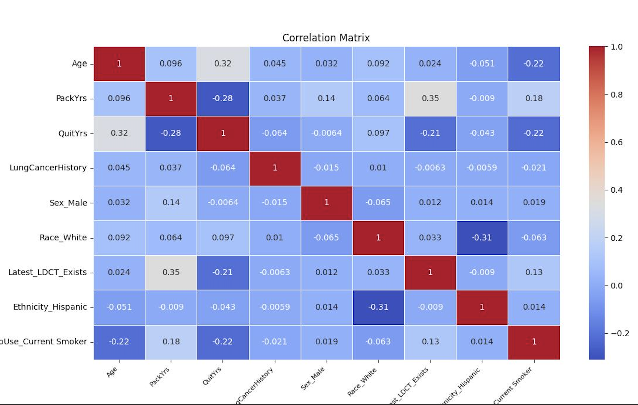
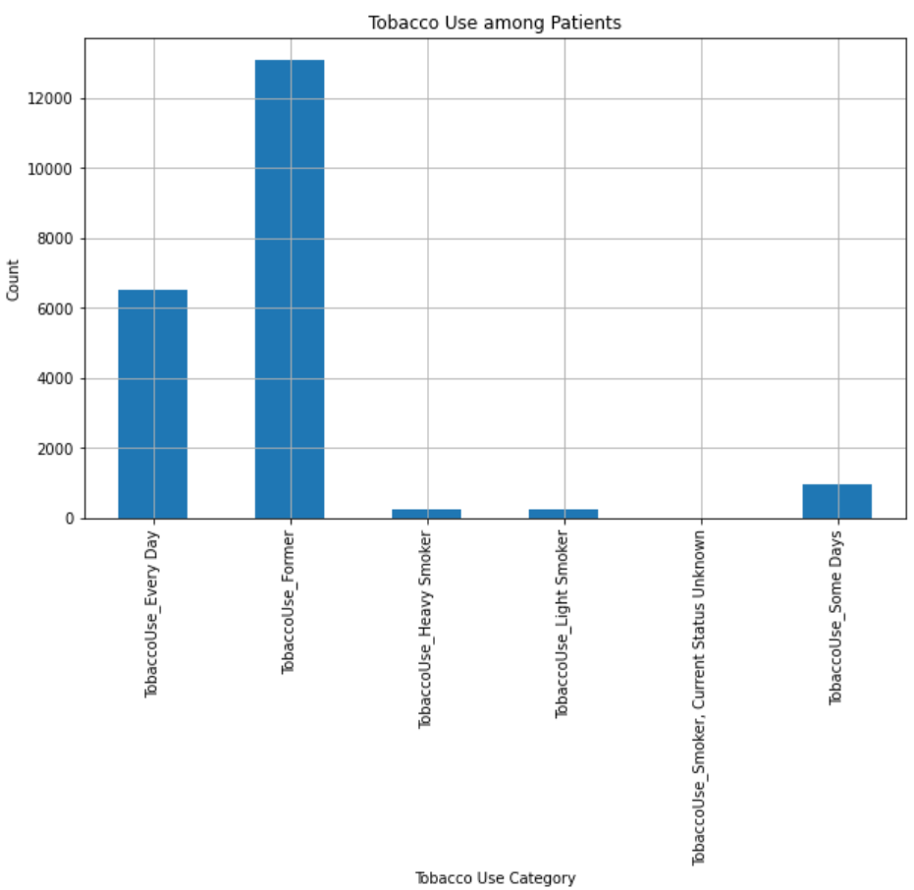
Distribution + Correlation Matrix

Slide 8
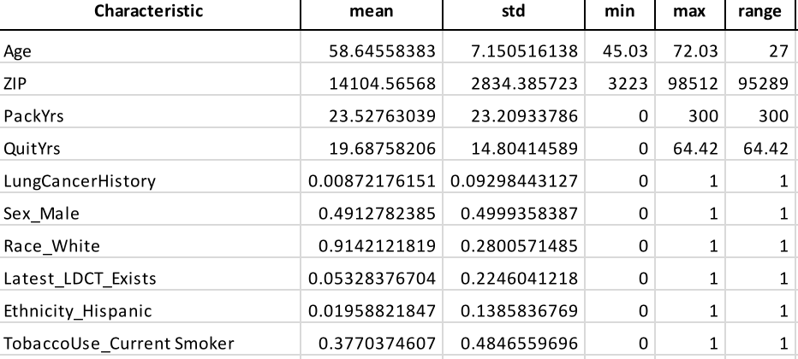
Descriptive Statistics

Slide 9
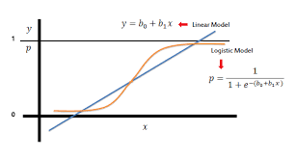
Methods - Logistic Regression
Uses logistic functions to predict the probability of a binary outcome
Log odds = logarithm of the odds
Odds ratio = strength of association between a predictor variable and the odds of the outcome variable

Slide 10
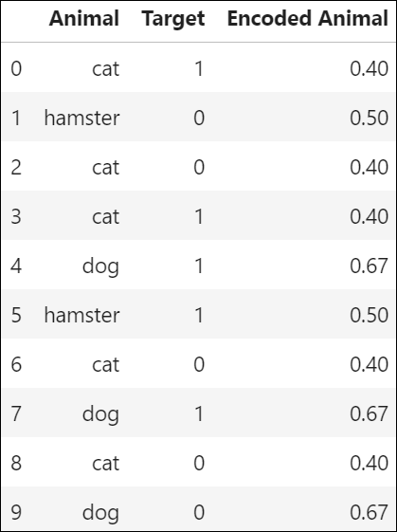
Methods - Target Encoding
Simple Example:
Used in analysis for ZIP codes
Replaces a feature’s categories with a number derived from the target
Beneficial for variables with a large set of different responses
(Avoids curse of dimensionality)

Slide 11
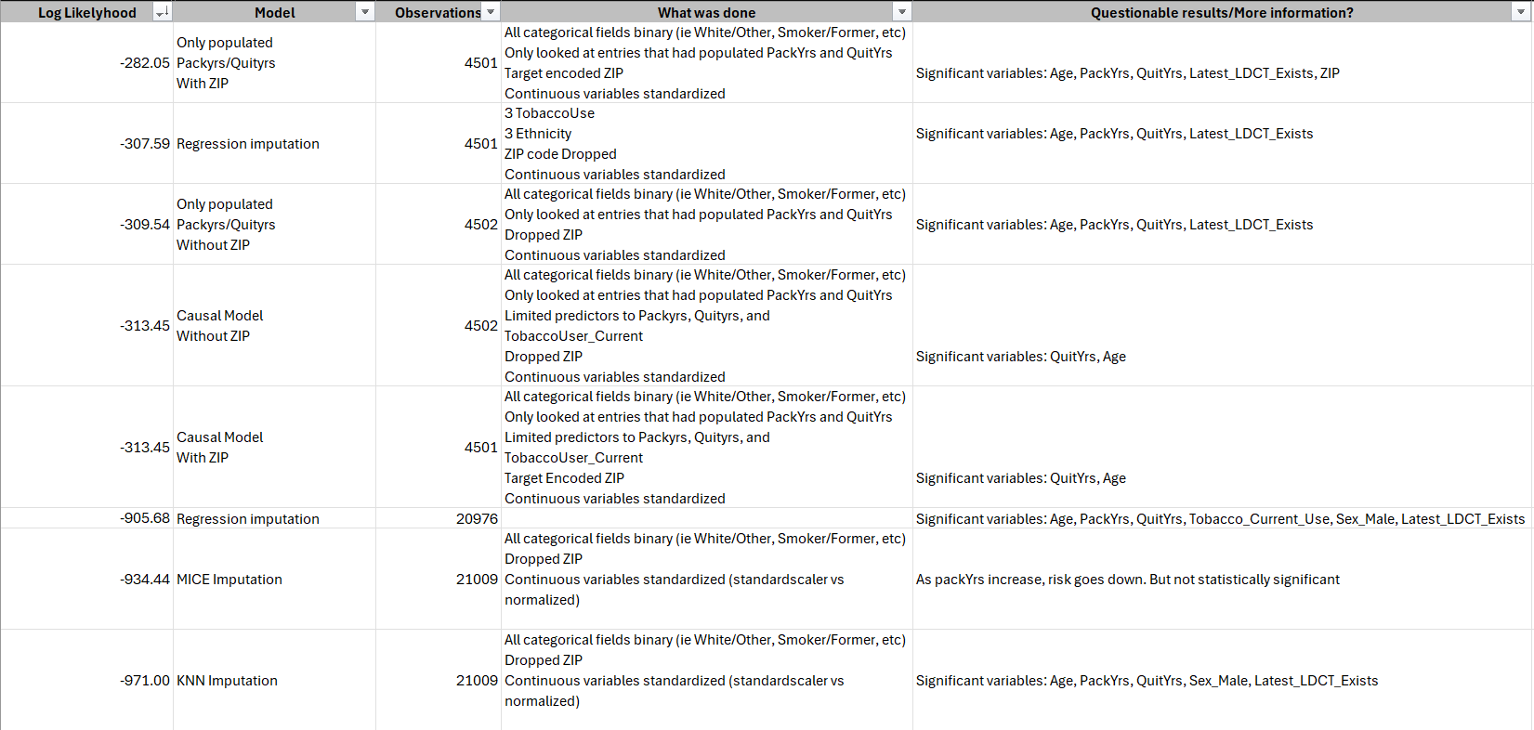
Notes:
Include a finished table 3

Slide 12
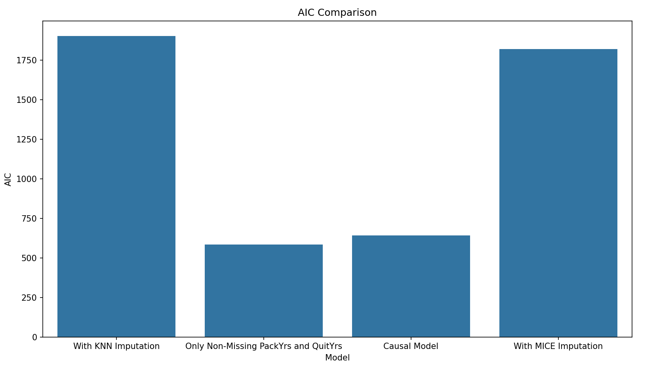
Analysis Results
AIC is a calculation used to compare different models
Uses the model’s log likelihood with a penalty for the number of parameters
Goodness of fit vs model complexity

Slide 13
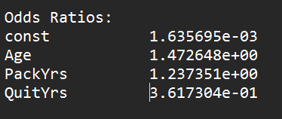
Analysis Results - Best Model
Significant Variables:
Age, PackYrs, QuitYrs, Latest_LDCT_Exists
Method:
Only used populated PackYrs and QuitYRs
All categorical variables binary
Mean target encoded ZIP
Continuous variables standardized
No. Observations | 4501
Pseudo R-Squared | 0.1599
Log-Likelihood | -282.05
Notes:
Include best model, what was done to prepare, what methods were used in model

Slide 14
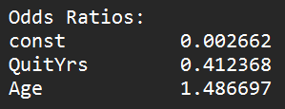
Analysis Results - Causal Model
Significant Variables:
Age, QuitYrs
Method:
Limited predictors to Age, PackYrs, and QuitYrs
Only used records with populated PackYrs and QuitYrs
All categorical variables binary
Target Encoded ZIP
Continuous variables standardized
No. Observations | 4501
Log-Likelihood | -313.45
Notes:
Include best model, what was done to prepare, what methods were used in model

Slide 15
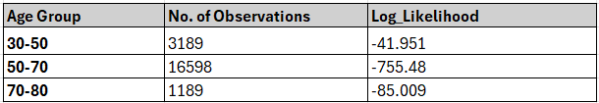
Sub Sample Analysis
Method:
The dataset was divided into sub samples based on different age groups.
All categorical variables binary.
After Regression imputation, Logit model was applied to each subset of data.
Features used for analysis:
PackYrs,
QuitYrs,
Tobacco_CurrentUse,
Age,
Sex_Male,
Race_White,
Ethnicity_Unknown,
Ethnicity_Hispanic,
Latest_LDCT_Exists

Slide 16
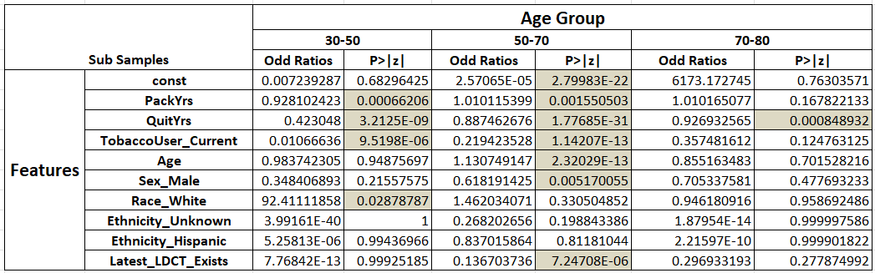
Sub Sample Analysis
Significant Variables:
For age group 30-50, PackYrs, QuitYrs, TobaccoUser_Current and Race_White seem to be the significant features.
Similarly for age group
50-70, PackYrs, QuitYrs,
TobaccoUser_Current,
Age,Sex_Male and
Latest_LDCT_exists
are the significant features.
For age group 70-80,
It is just the QuitYrs.

Slide 17
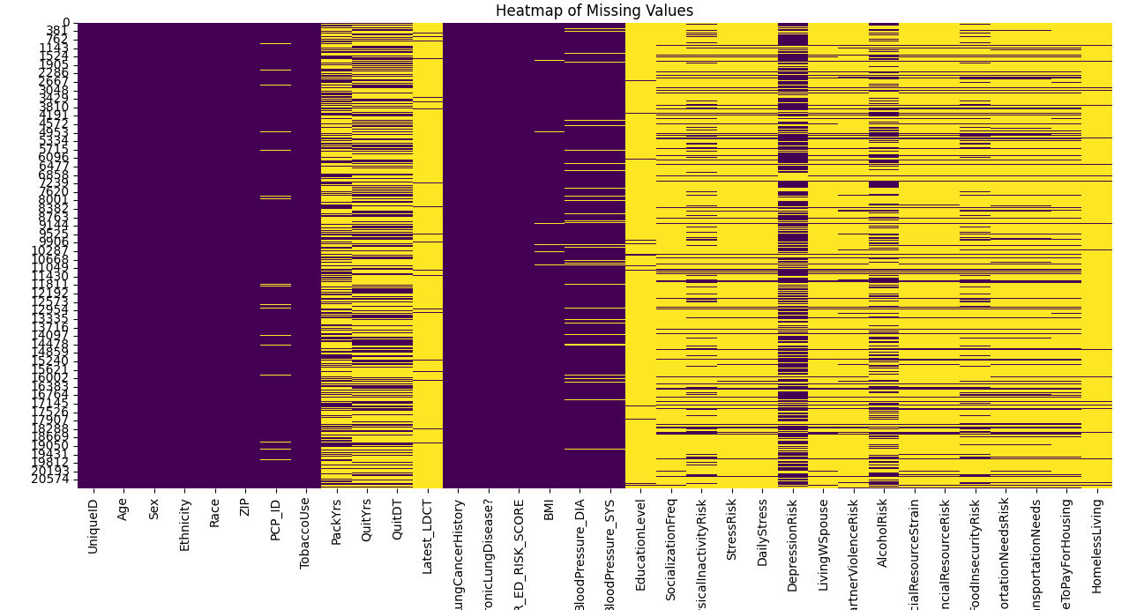
Social Determinants of Health Dataset
SDOH dataset includes 34 variables, introducing more external factors to lung cancer analysis
Data Cleaning & Limitations:
Initial analysis done with time restraint
New variables are > 50% null

Slide 18
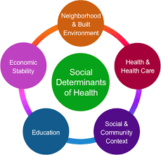
Social Determinants of Health -
Initial Analysis
Age | 55.1%
PackYrs | 12.1%
QuitYrs | –25.8%
Risk_Score | 14.1%
Chronic LD | 369%
Significant Variables: PackYrs, QuitYrs, HOSP_OR_ED_RISK_SCORE, Chronic Lung Disease
Future Analysis:
Null Values - drop or perform imputation
Subset Analysis - internal versus external factors
Target encoding vs one-hot

Slide 19
Implications
Most common significant variables: Age, PackYrs, QuitYrs.
Sex (Male) and Tobacco_Current_Use also frequently appear
Residents in Broome County who are likely to have a positive lung cancer history if they have any of any of the below:
Older: 47.3% increased odds per year
More Pack Yrs: 23.7% increased odds per year
Reduced QuitYrs: -63.8% decreased odds per year
Age | 47.3%
PackYrs | 23.7%
QuitYrs | -63.8%

